Slide 1

Numerical Differentiation
Estimate the derivatives (slope, curvature, etc.) of a function by using the function values at only a set of discrete points
Ordinary differential equation (ODE)
Partial differential equation (PDE)
Represent the function by Taylor polynomials or Lagrange interpolation
Evaluate the derivatives of the interpolation polynomial at selected nodal points

Slide 2
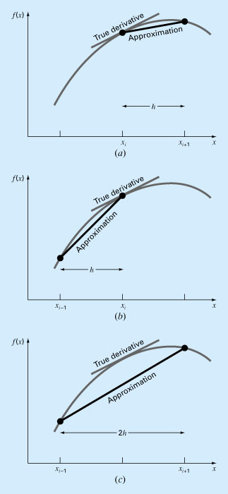
Forward difference
Numerical Differentiation
Backward difference
Centered difference

Slide 3
Forward difference
True derivative
Approximation
h
x
x_{i−1} x_{i} x_{i+1}

Slide 4
Backward difference
True derivative
Approximation
h
x
x_{i−1} x_{i} x_{i+1}

Slide 5
Centered difference
True derivative
Approximation
2h
x
x_{i−1} x_{i} x_{i+1}

Slide 6
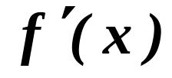
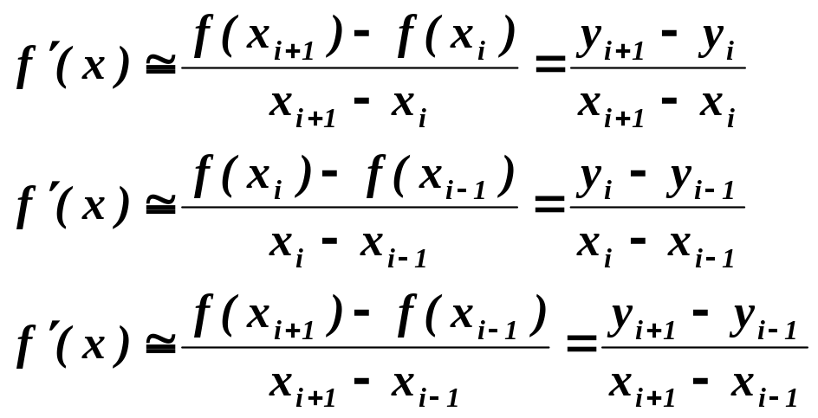
First Derivatives
y
x
i-2 i-1 i i+1 i+2
Forward difference
Backward difference
Central difference

Slide 7
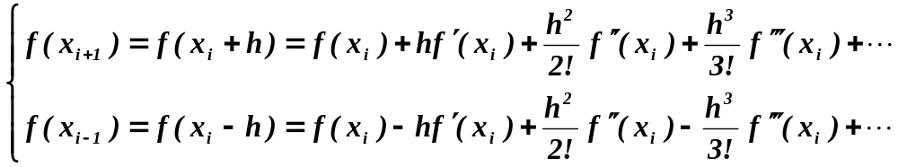
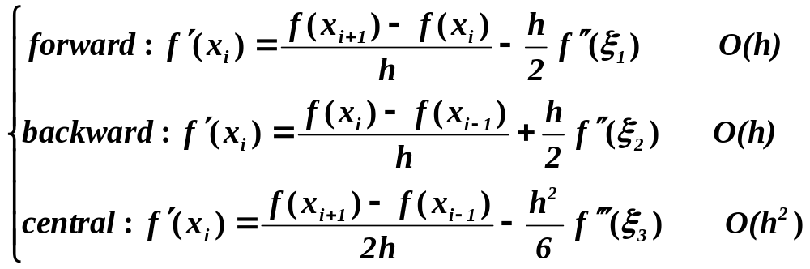
Truncation Errors
Uniform grid spacing

Slide 8
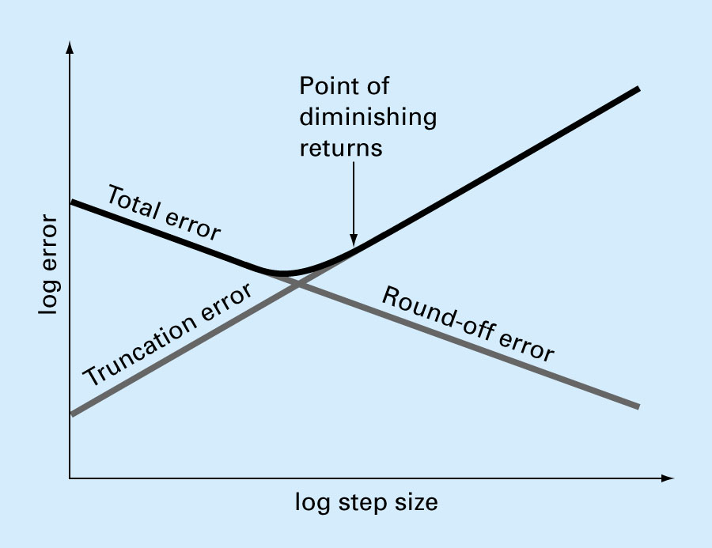
Trade-off between truncation and round-off errors
Total Numerical Error

Slide 9
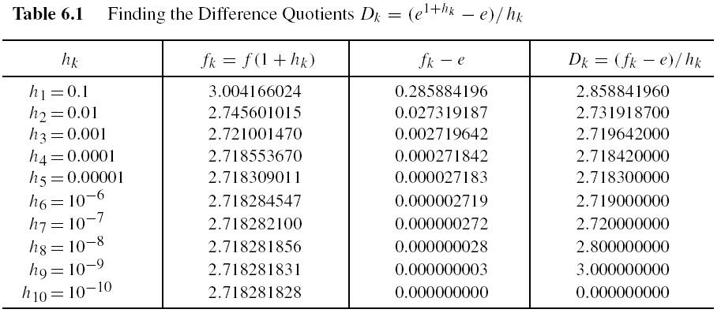
Round-off errors (Page 322)

Slide 10
Home Assignment
Pages 334 and 335 – Exercises 1 and 4

Slide 11
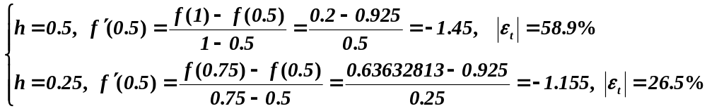
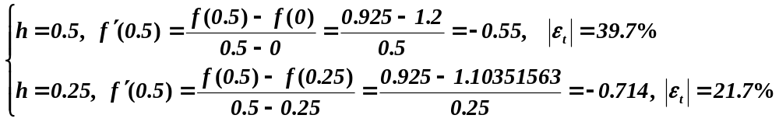
Example: First Derivatives
Use forward and backward difference approximations to estimate the first derivative of
at x = 0.5 with h = 0.5 and 0.25 (exact sol. = -0.9125)
Forward Difference
Backward Difference

Slide 12
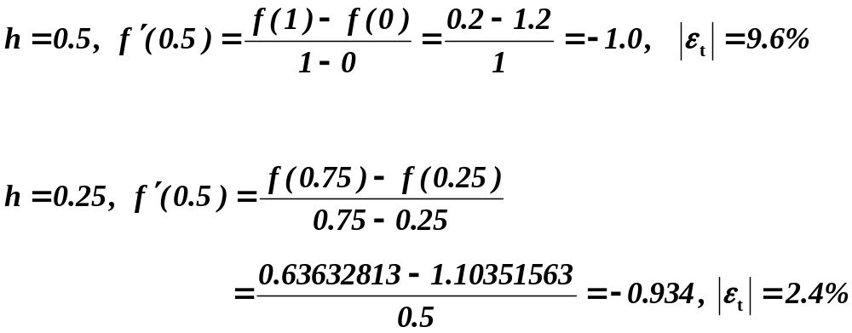
Example: First Derivative
Use central difference approximation to estimate the first derivative of
at x = 0.5 with h = 0.5 and 0.25 (exact sol. = -0.9125)
Central Difference

Slide 13
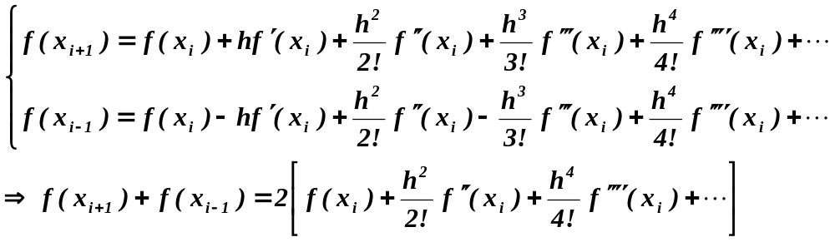
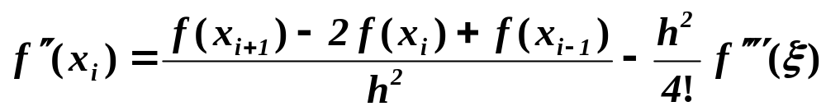
Second-Derivatives
Taylor-series expansion
Uniform grid spacing
Second-order accurate O(h²)

Slide 14
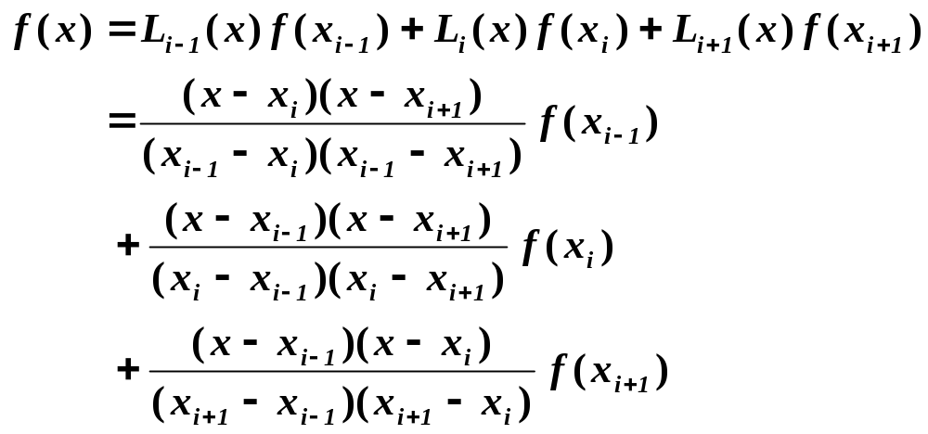
General Three-Point Formula
Lagrange interpolation polynomial for unequally spaced data

Slide 15
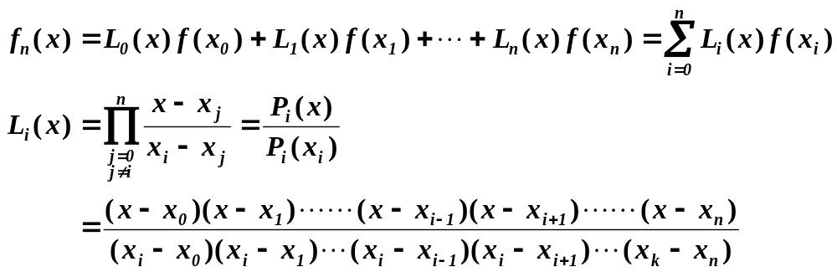
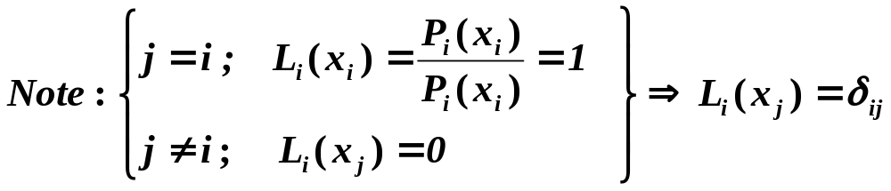
Lagrange Polynomials
General form

Slide 16
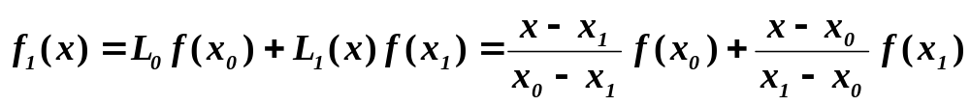
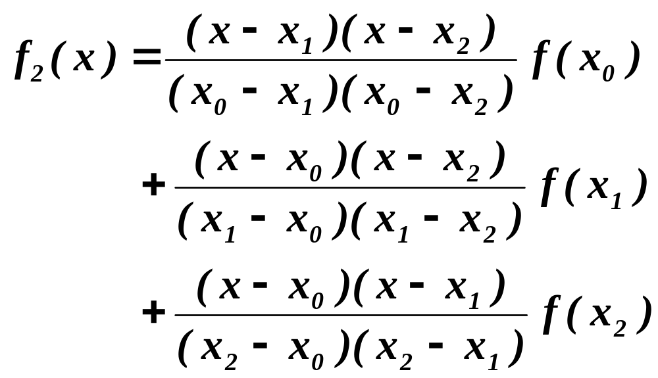
Lagrange Interpolation
1st-order Lagrange polynomial
Second-order Lagrange polynomial

Slide 17
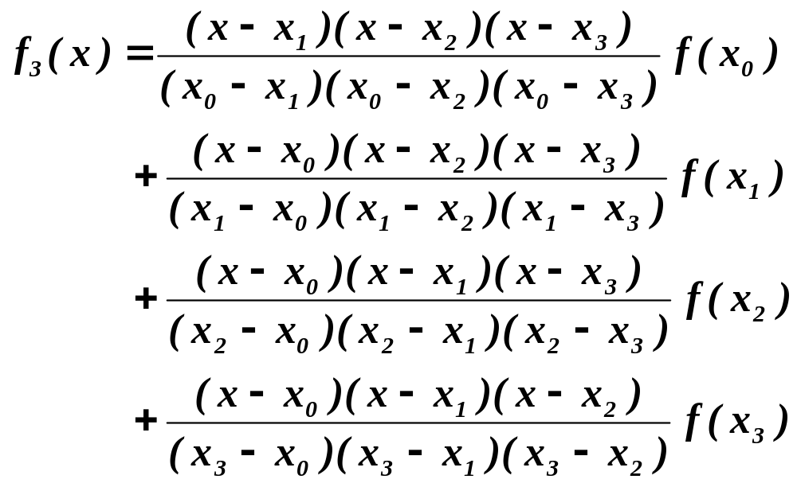
Lagrange Interpolation
Third-order Lagrange polynomial

Slide 18
Lagrange Interpolation
L₀(x)f(x₀)
L₂(x)f(x₂)
x₀
x₁
x₂
L₁(x)f(x₁)

Slide 19
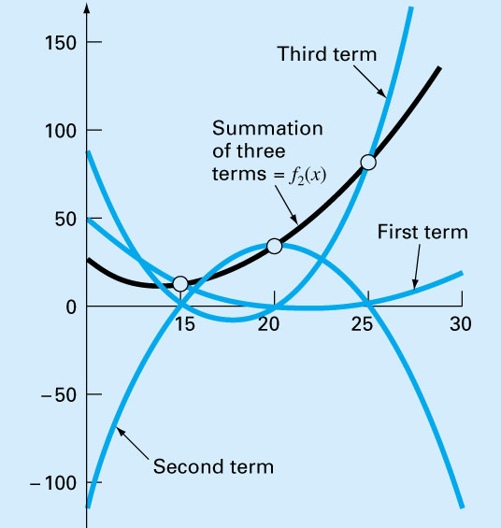
Lagrange Polynomial

Slide 20
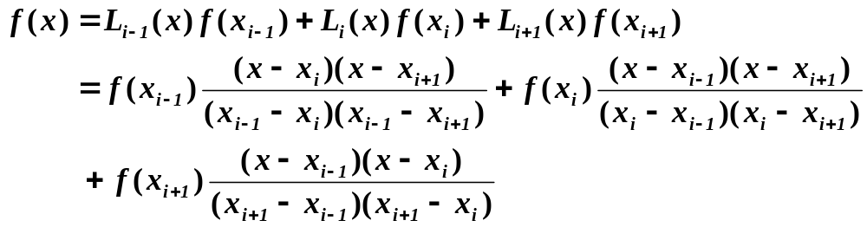
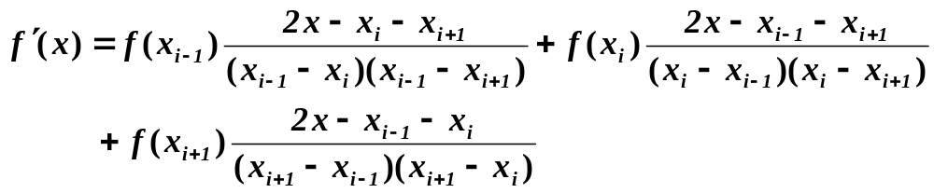
General Three-Point Formula
Lagrange interpolation polynomial for unequally spaced data
First derivative

Slide 21
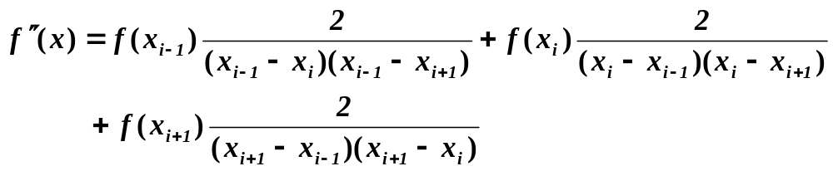
Second Derivative
First Derivative for unequally spaced data
Second Derivative for unequally spaced data

Slide 22
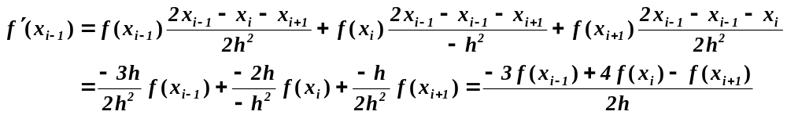
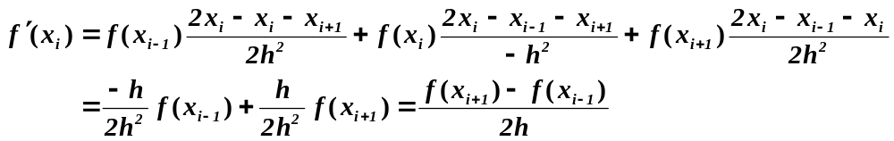
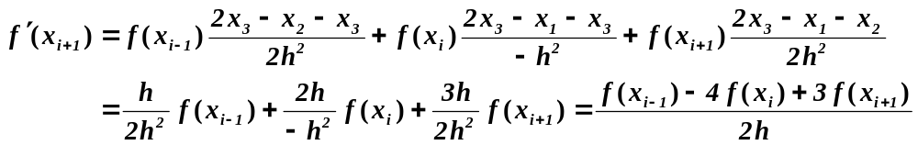
Three-point formula (Uniform Grid)
Forward difference
Centered difference
Backward difference

Slide 23
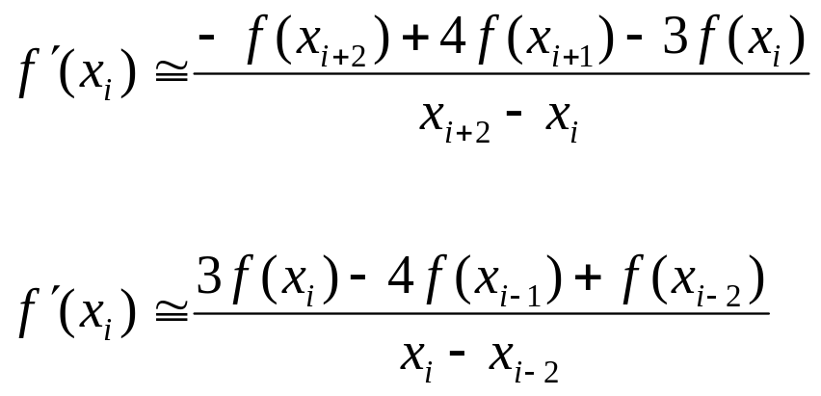
First Derivatives
Parabolic curve
i-2 i-1 i i+1 i+2
3 -point Forward difference
3 -point Backward difference

Slide 24
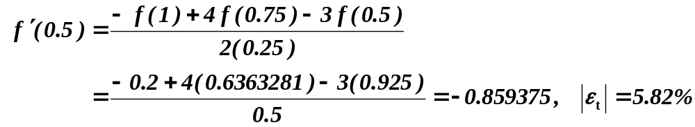
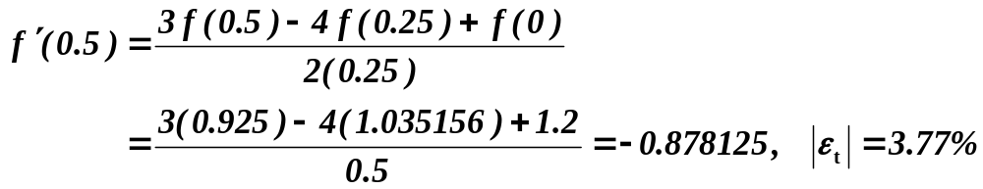
Example: First Derivatives
Use forward and backward difference approximations of O(h²) to estimate the first derivative of
at x = 0.5 with h = 0.25 (exact sol. = -0.9125)
Forward Difference
Backward Difference

Slide 25
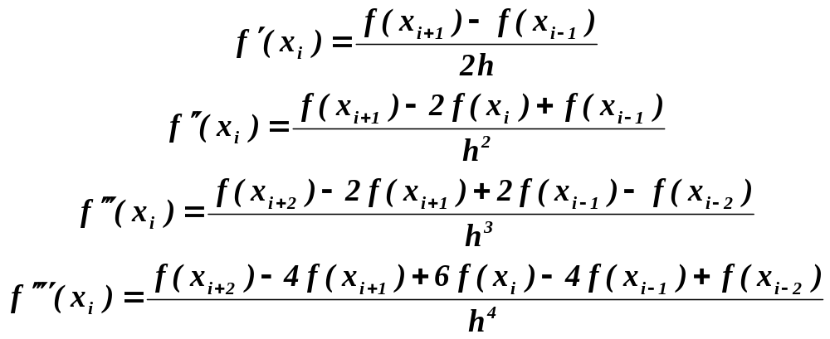
Higher Derivatives
All second-order accurate O(h²)
More nodal points are needed for higher derivatives
Higher order formula may be derived

Slide 26
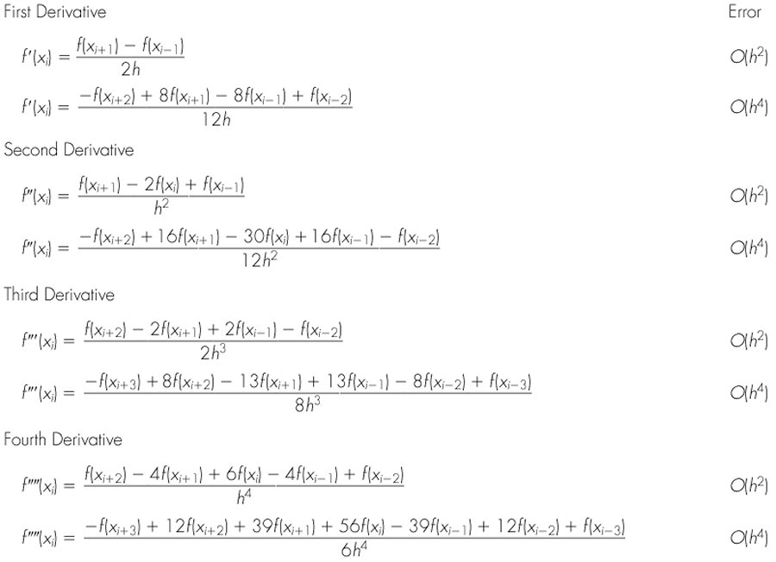
Centered Finite-Divided Differences

Slide 27
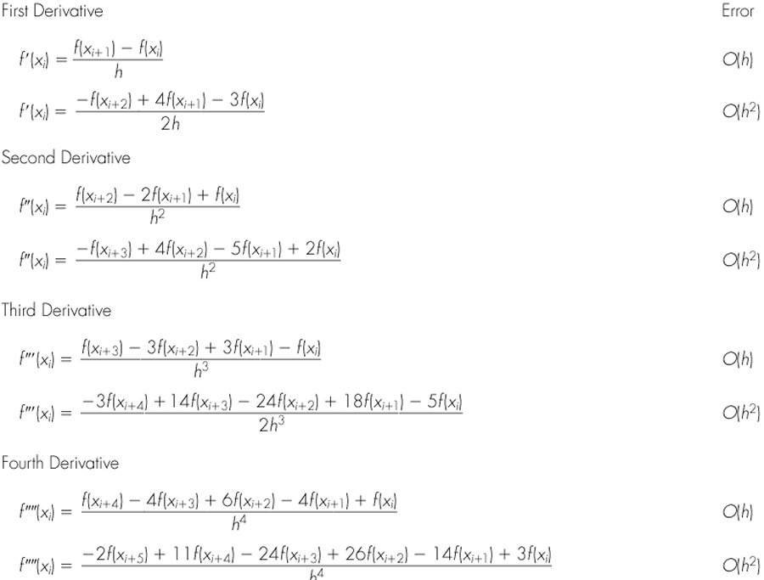
Forward Finite-divided differences

Slide 28
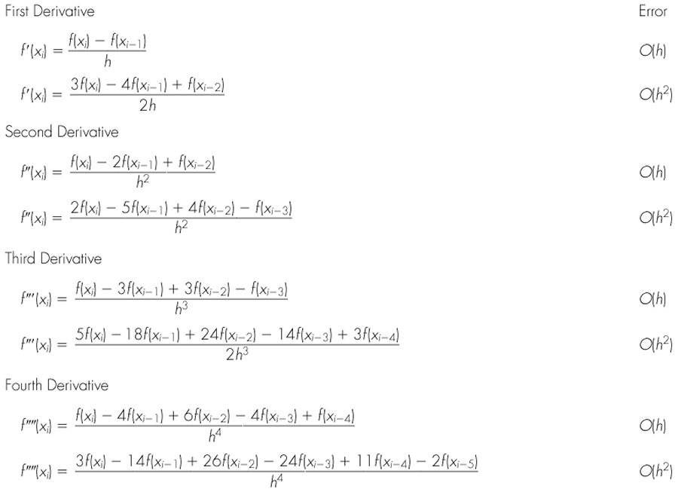
Backward finite-divided differences

Slide 29
Home Assignment
Page 349 – Exercise 1
[J44] 张雨浓, 郭东生, 徐思洪, 李海林, 未知目标函数之一阶数值微分公式验证与实践, 甘肃科学学报, 2009年3月, 第21卷第1期, 13-18
[C74] Yunong Zhang, Dongsheng Guo, Chenfu Yi, Lingfeng Li, Zhende Ke, More Than Newton Iterations Generalized from Zhang Neural Network for Constant Matrix Inversion Aided with Line-Search Algorithm, Proceedings of the 8th IEEE International Conference on Control and Automation, June 9-11, 2010, Xiamen, China, pp. 399-404

